Slide 1

Safeguarding Children's Spaces with AI Vision
An intelligent computer vision system designed to detect hazardous objects in children's environments before accidents happen, providing peace of mind for parents and carers.
גונקו דניאל 340969674
גבריס סבטלנה 342794732
סמיון אוסטרובסקי 342795754

Slide 2

The Challenge
Hidden Dangers in Safe Spaces
Parents and childminders face a constant challenge: identifying dangerous objects in children's rooms before they cause harm. Even in seemingly safe environments, small items, sharp objects, chemical bottles, or damaged cables can hide behind toys or lie on the floor.
These hidden hazards can lead to choking, injuries, or exposure to dangerous substances—often without warning.

Slide 3

Innovation Through Synthetic Data
No existing open dataset focuses specifically on hazardous objects in children's rooms.

Slide 4
Why Traditional Data Collection Fails
Privacy Concerns
Ethical Barriers
Rare Occurrences
Collecting real images from homes raises serious privacy issues for families.
Deliberately exposing children to dangerous situations for photography is unacceptable.
Most hazardous situations are infrequent and difficult to document authentically.
These limitations make synthetic data generation through GenAI models essential for creating a robust, safe, and privacy-preserving training dataset.

Slide 5




Four Critical Danger Categories
Choking Hazards
Sharp Objects
Coins, lego, batteries
Scissors and knives
Chemical Dangers
Electrical Hazards
Household chemicals.
Sockets ,adapters , wires

Slide 6

The ML Task: Object Detection for Safety
Input
Example Detection
Picture of a children's room
Battery on carpet → Bounding box + " choking hazard"
Output
Scissors on table edge → Bounding box + "Sharp object"
Bounding boxes around detected objects
Category labels from 4 danger types
Cleaning bottle near toys → Bounding box + "Chemical hazard"

Slide 7

Synthetic Data Generation Strategy
We employ advanced generative models including Stable Diffusion, ControlNet, and Inpainting techniques to create diverse children's room scenarios.
Controlled Variables
Multiple camera angles
Varied lighting conditions
Different clutter levels (tidy vs. toy-filled rooms)
Partial object occlusion (items behind toys, under furniture)
Negative examples (safe rooms without hazards for balanced training)

Slide 8
Data Generation & Prompt Engineering
Model: Stable Diffusion XL (SDXL) 1.0
Dataset Size: 2,000+ synthetic images generated
Core Strategy: Designing complex scene descriptions to simulate real-world child environments.
Prompt Components:
Environment: "Photorealistic children's bedroom", "natural daylight", "modern apartment".
Hazard Placement: "on a wooden floor", "under a desk", "near a toy shelf".
Technical Modifiers: "8k resolution", "DSLR photo", "highly detailed textures".
Negative Prompts: Used to exclude text, and low-quality artifacts to maintain focus on object detection.

Slide 9
Examples of prompts and images generated from them
"a household cleaning bottle under a desk in a children's room"
"A wide-angle photorealistic shot of a cluttered child's bedroom. Many small coins are scattered across the floor"
"Photorealistic nursery room, sharp scissors and a kitchen knife on a table, realistic shadows"

Slide 10
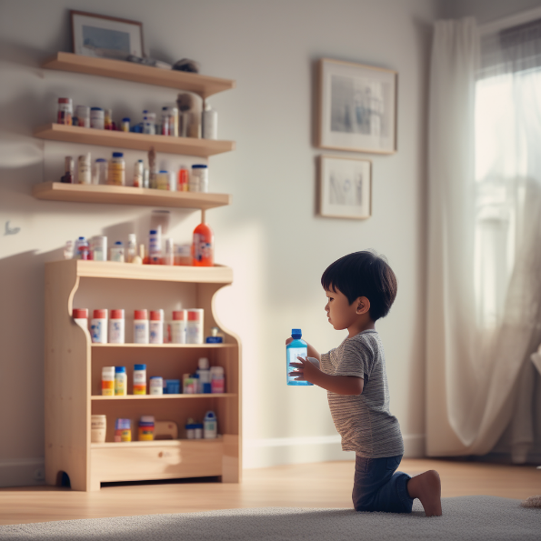

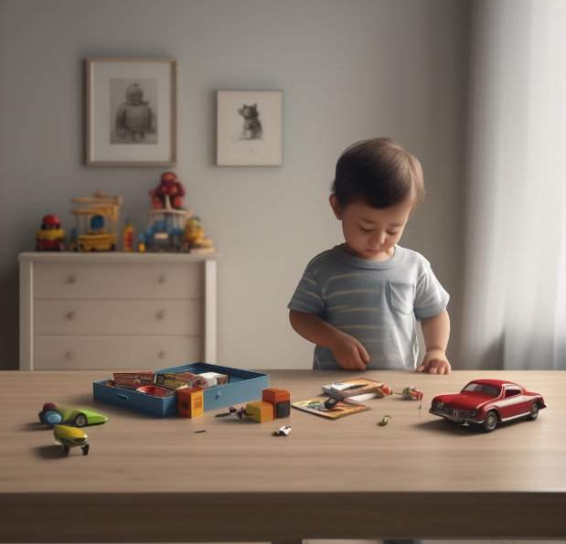


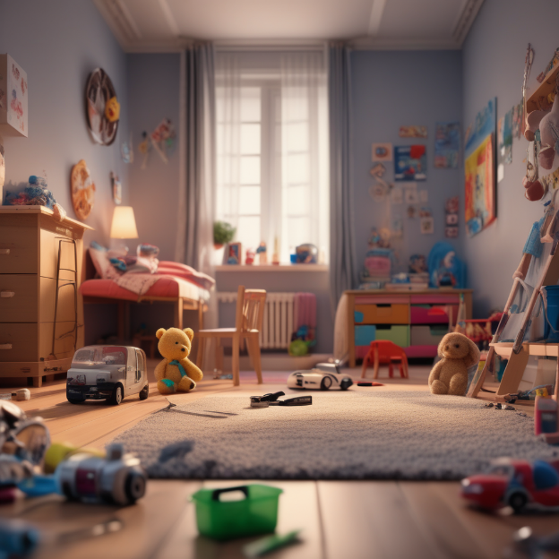

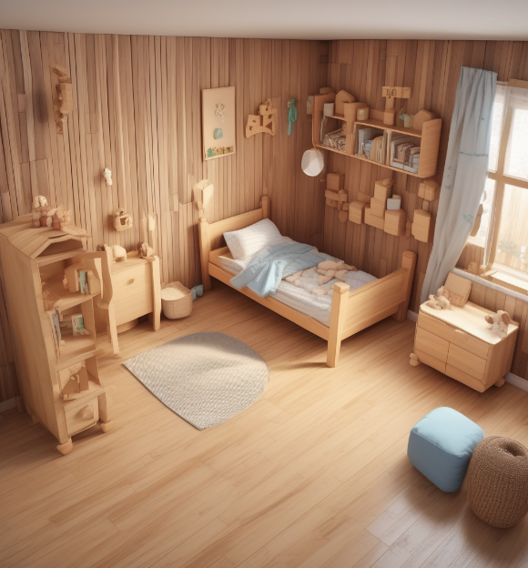
Sample data Children's rooms

Slide 11
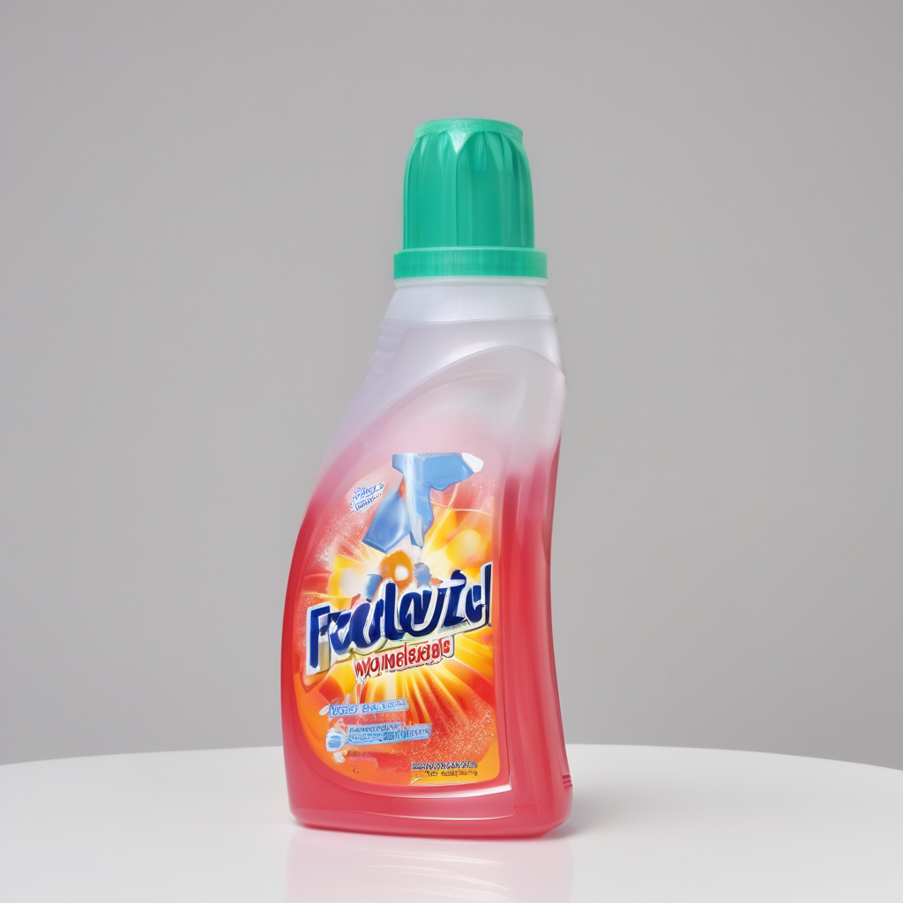

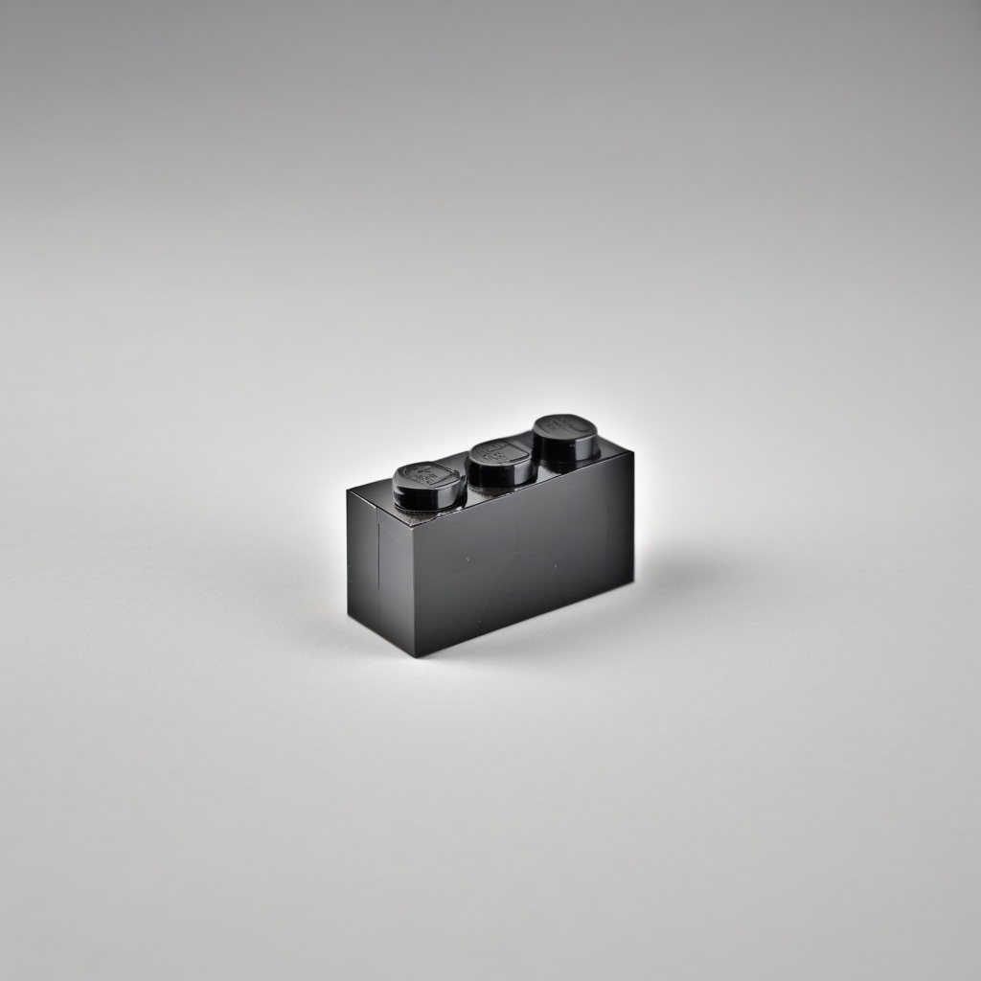

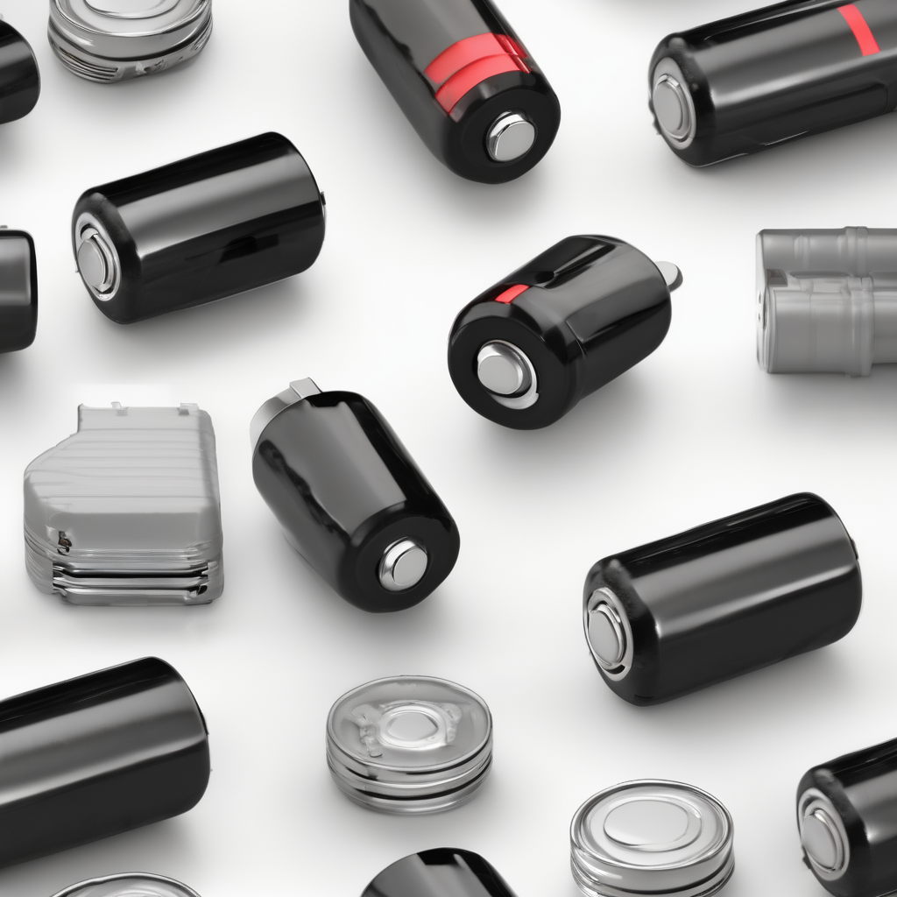
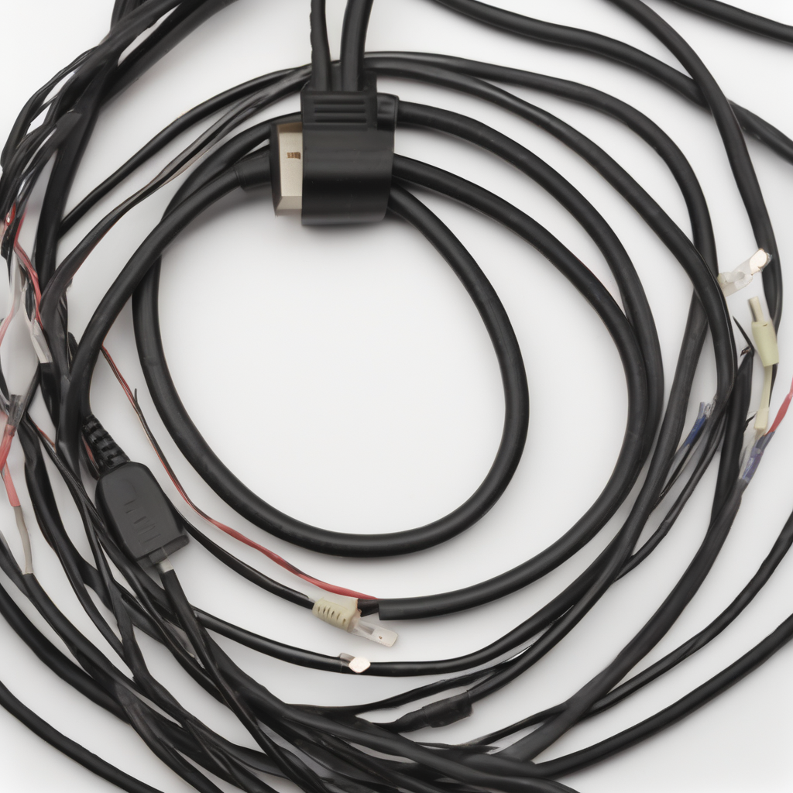


Sample data Individual objects

Slide 12



A model trained only on synthetic data
Model Selection & Experimental Design
SDXL
Grounding DINO
CVAT
YOLOv8/v10

Slide 13
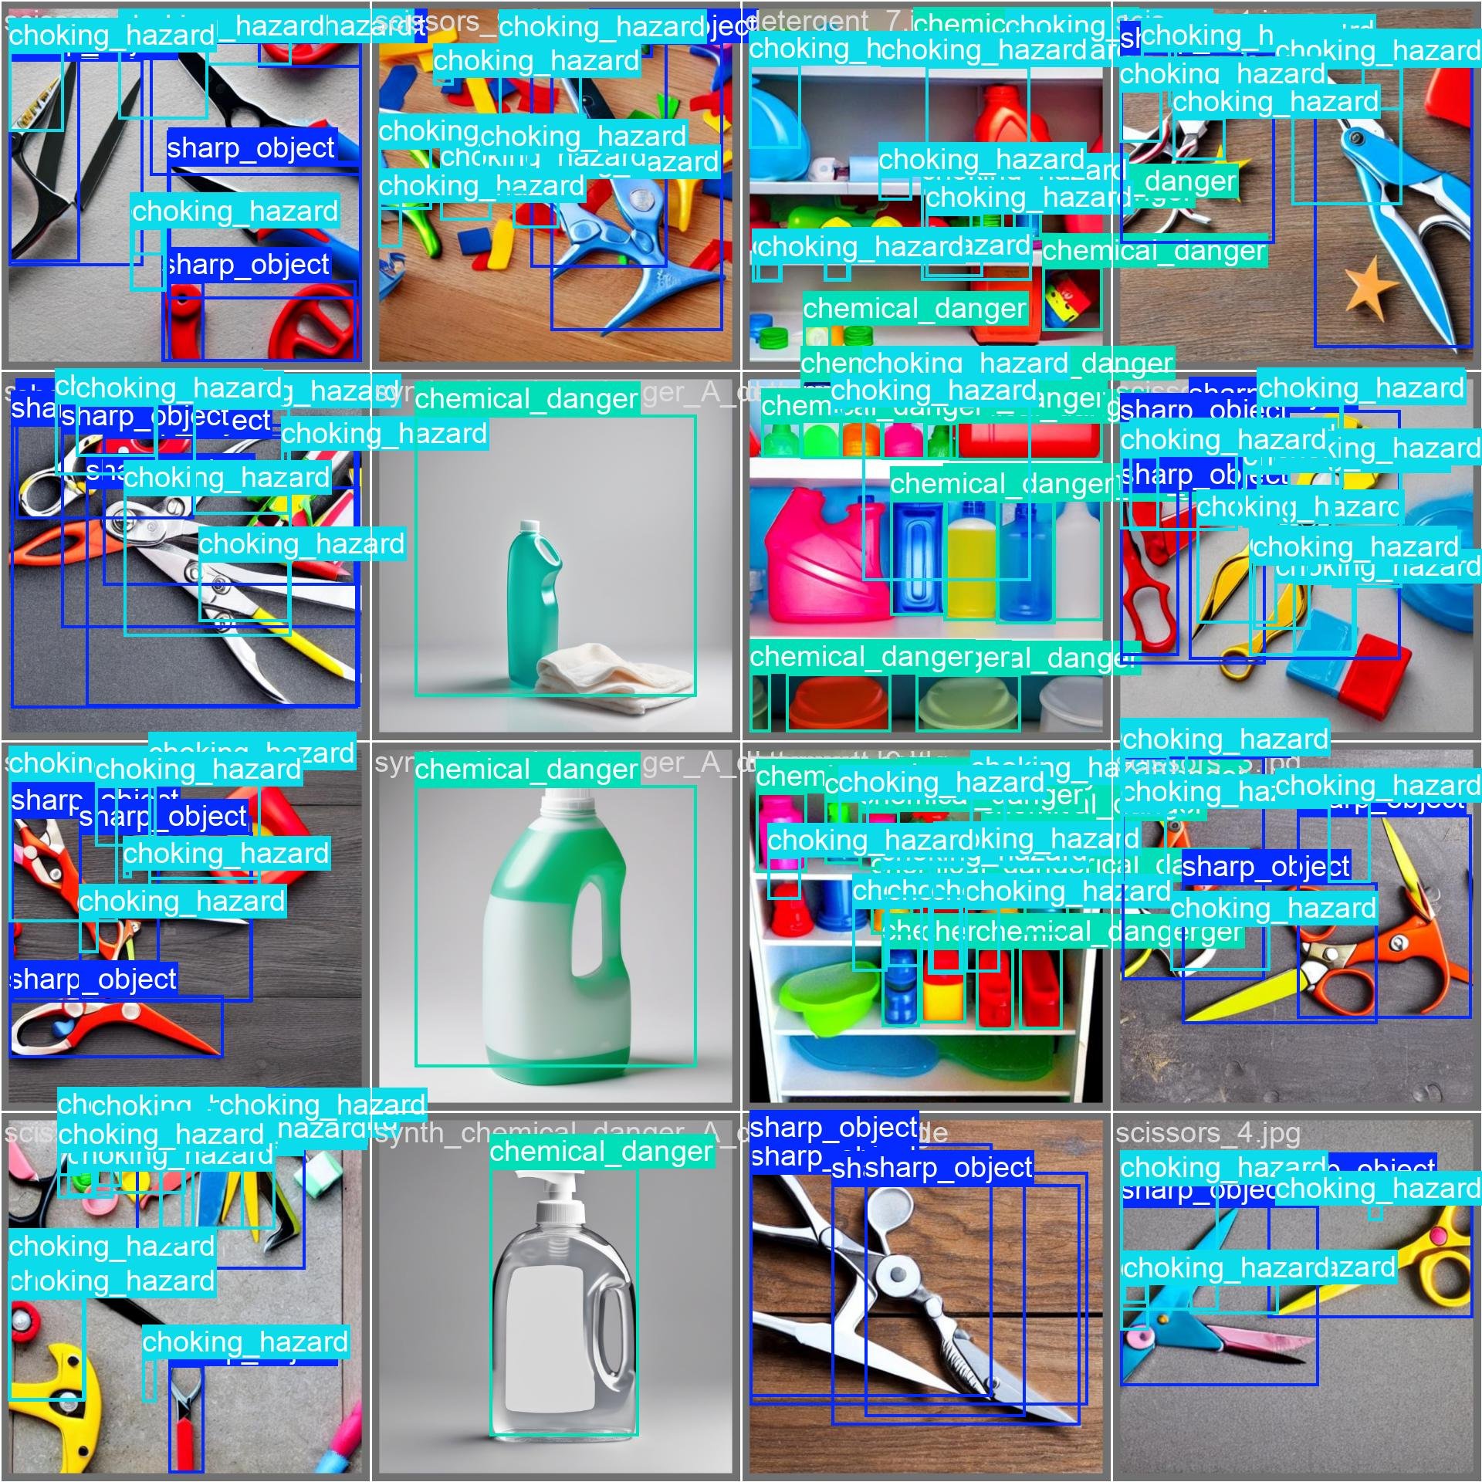
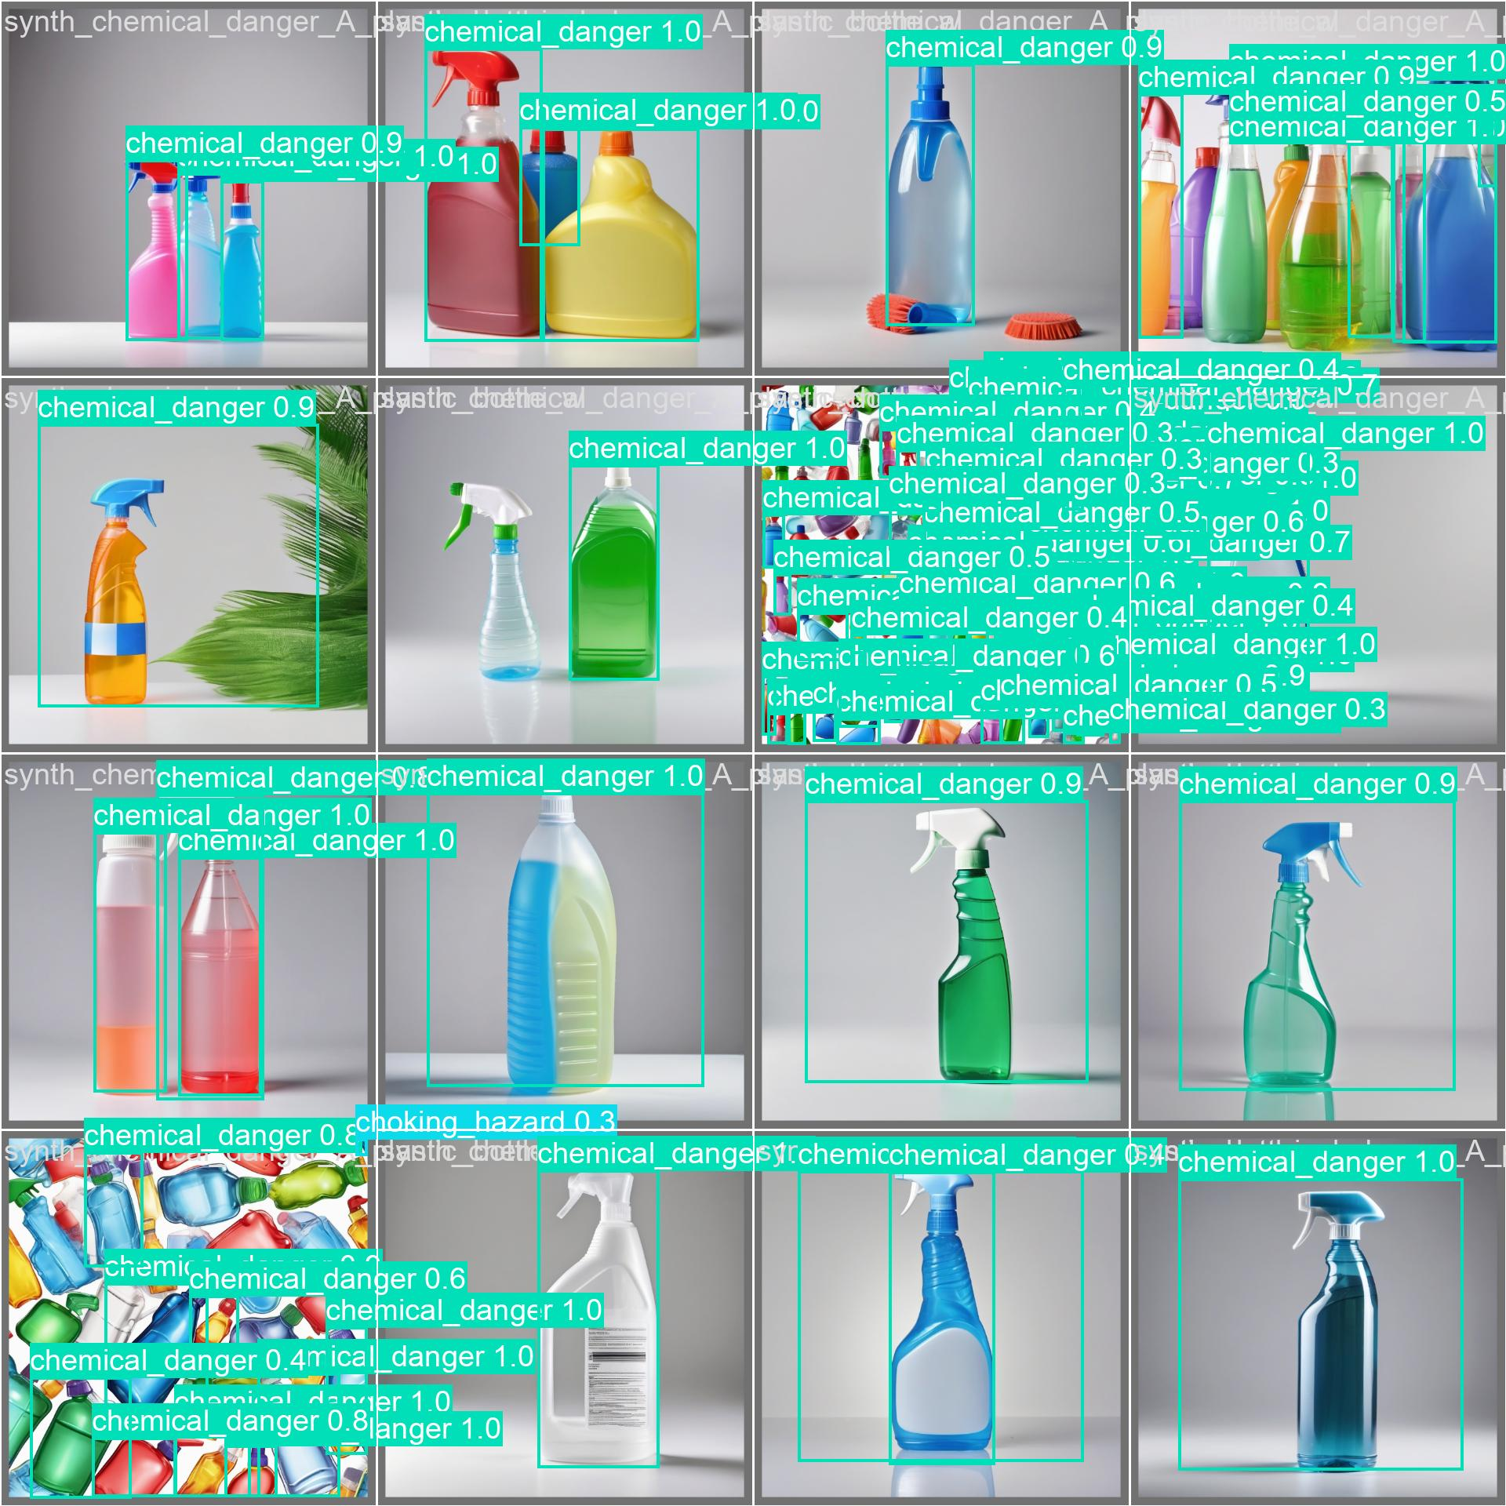

Slide 14
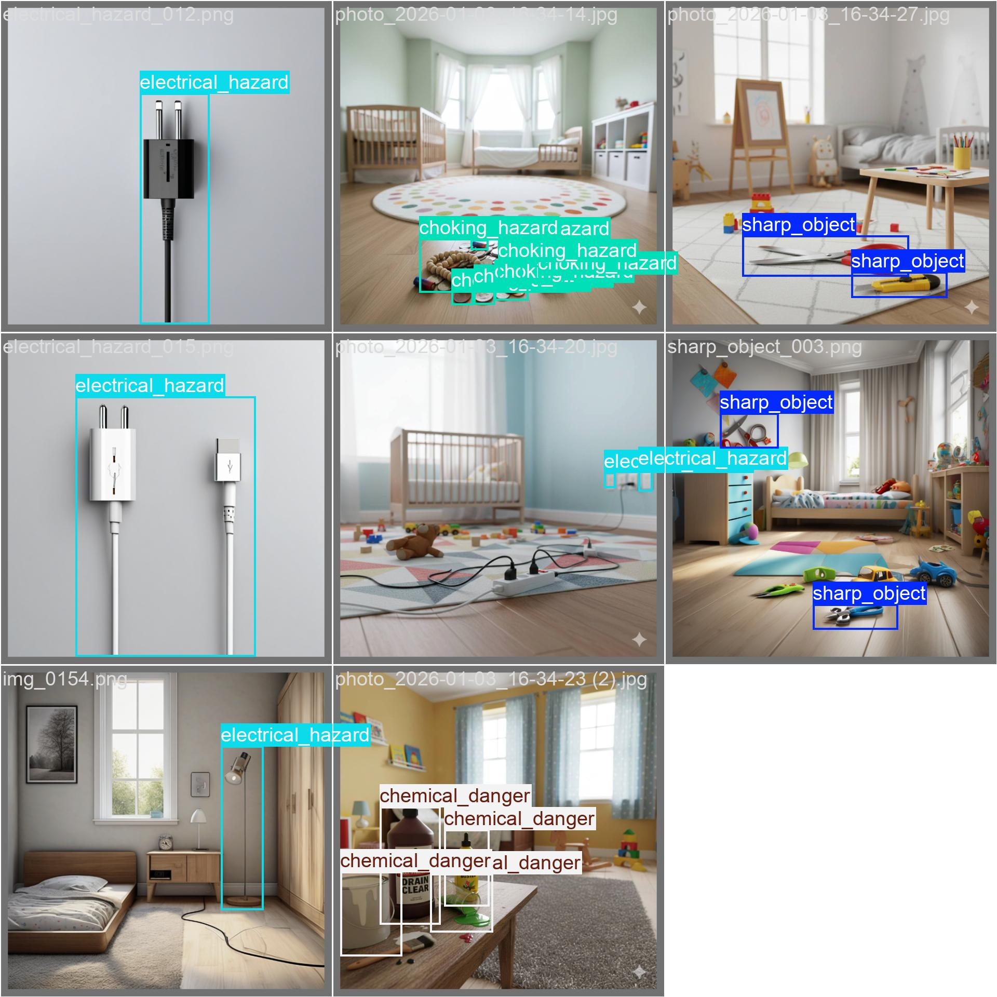
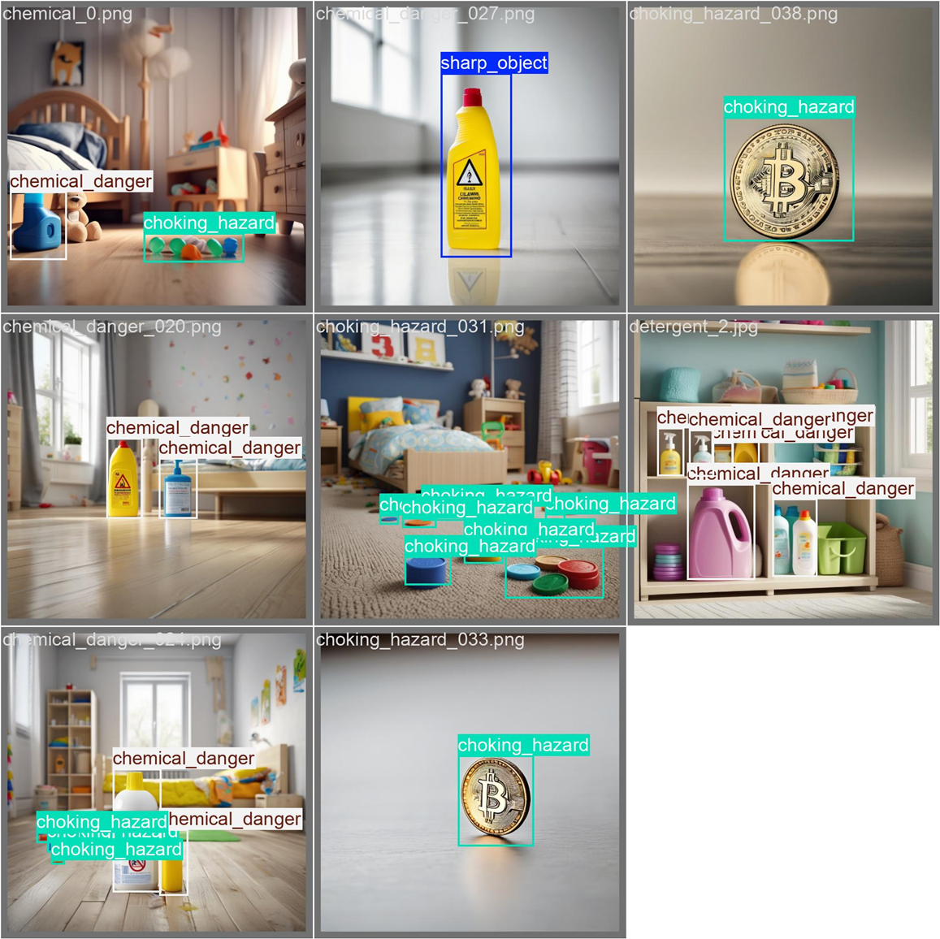

Slide 15
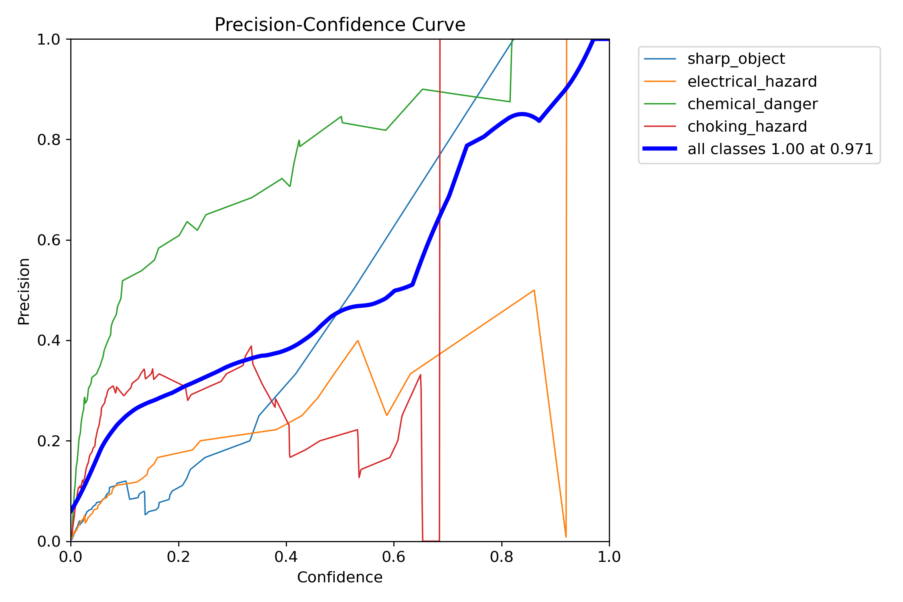
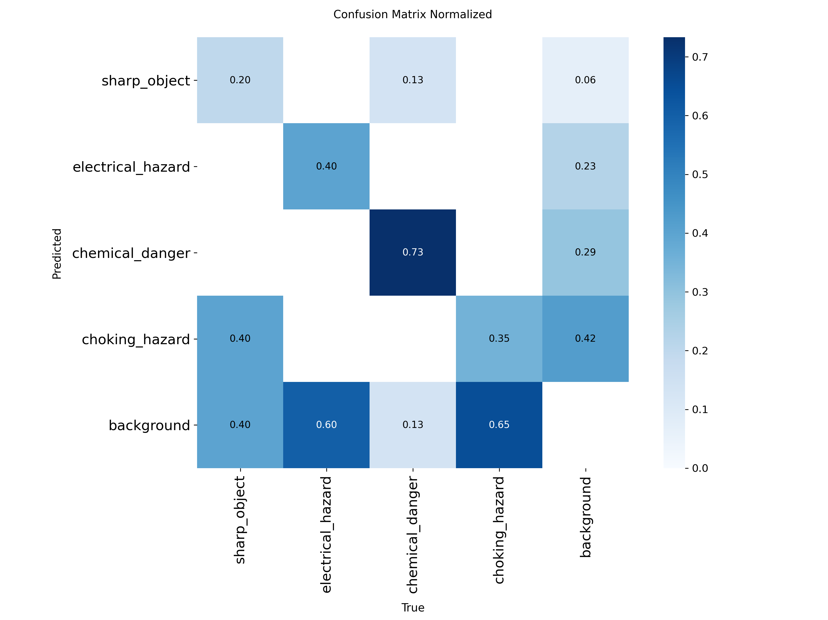
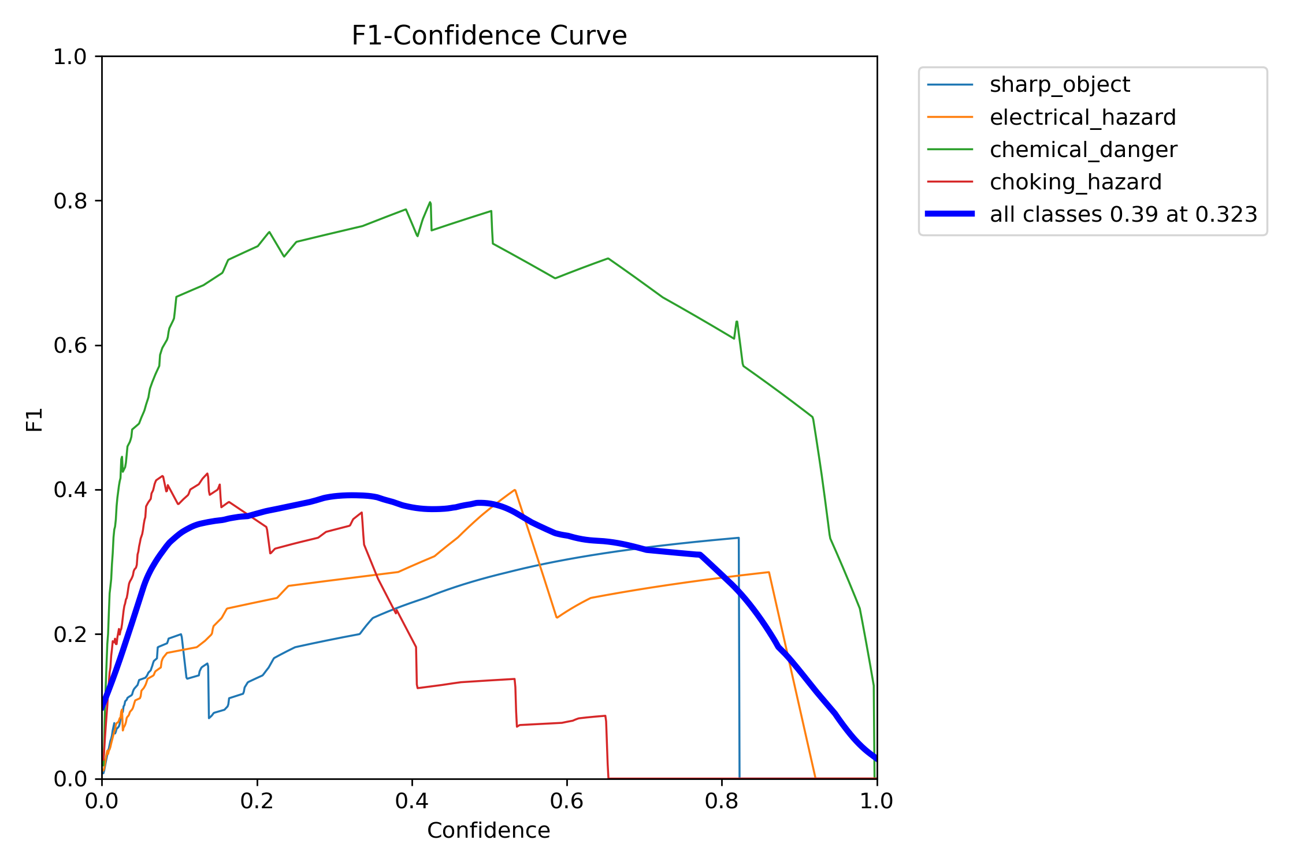
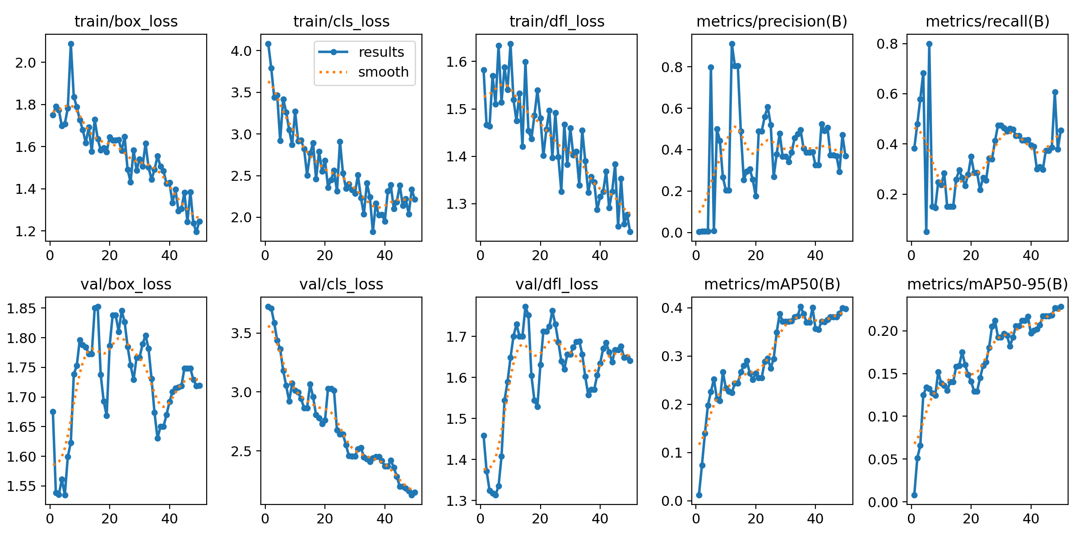
The results of a test models

Slide 16
A hybrid model trained on synthetic data created
by us and real objects photos from Roboflow
Model Selection & Experimental Design
SDXL
Roboflow
YOLOv8/v10

Slide 17
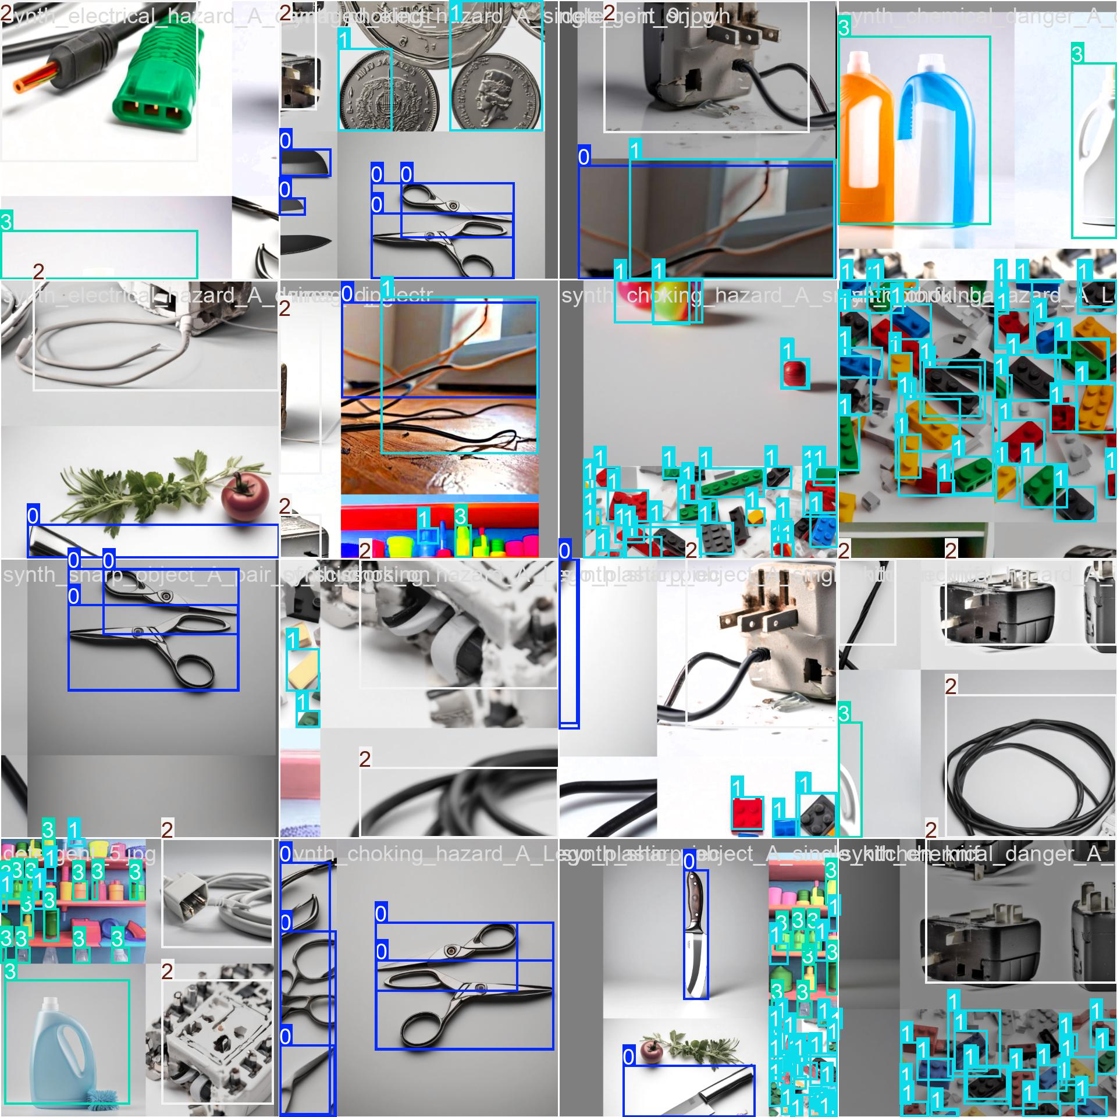
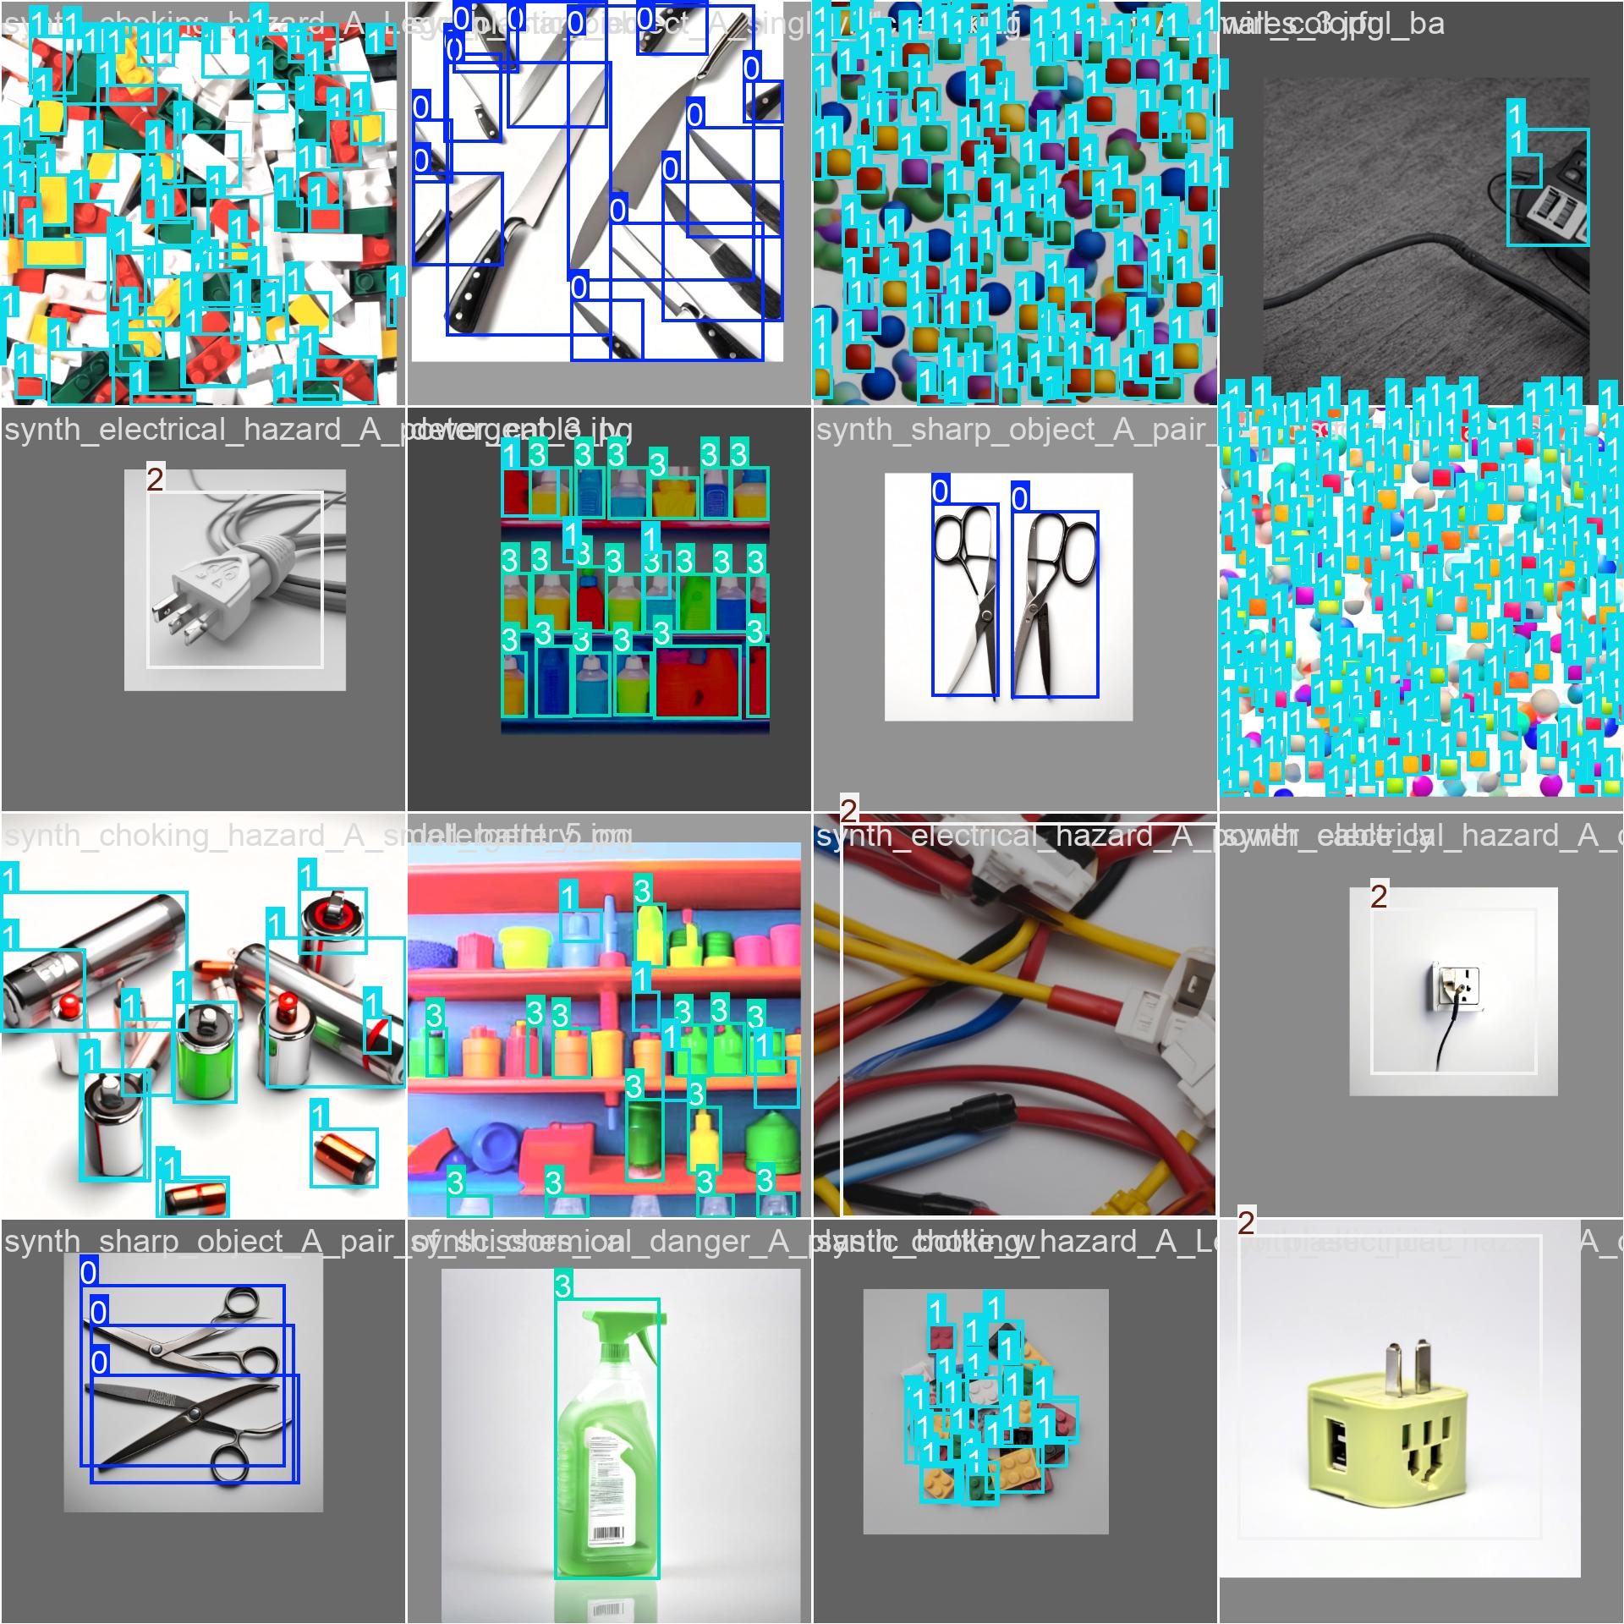

Slide 18
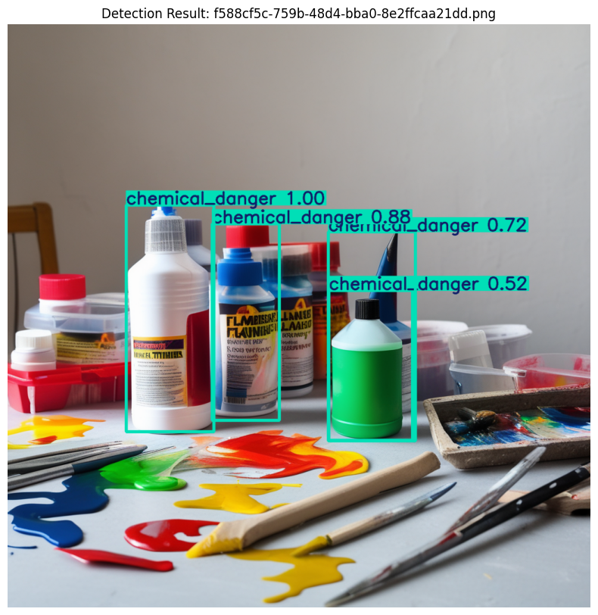
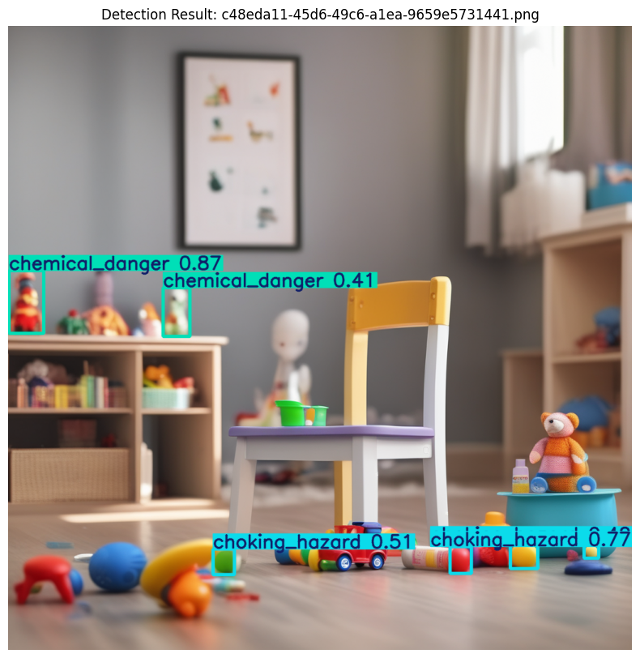

Slide 19
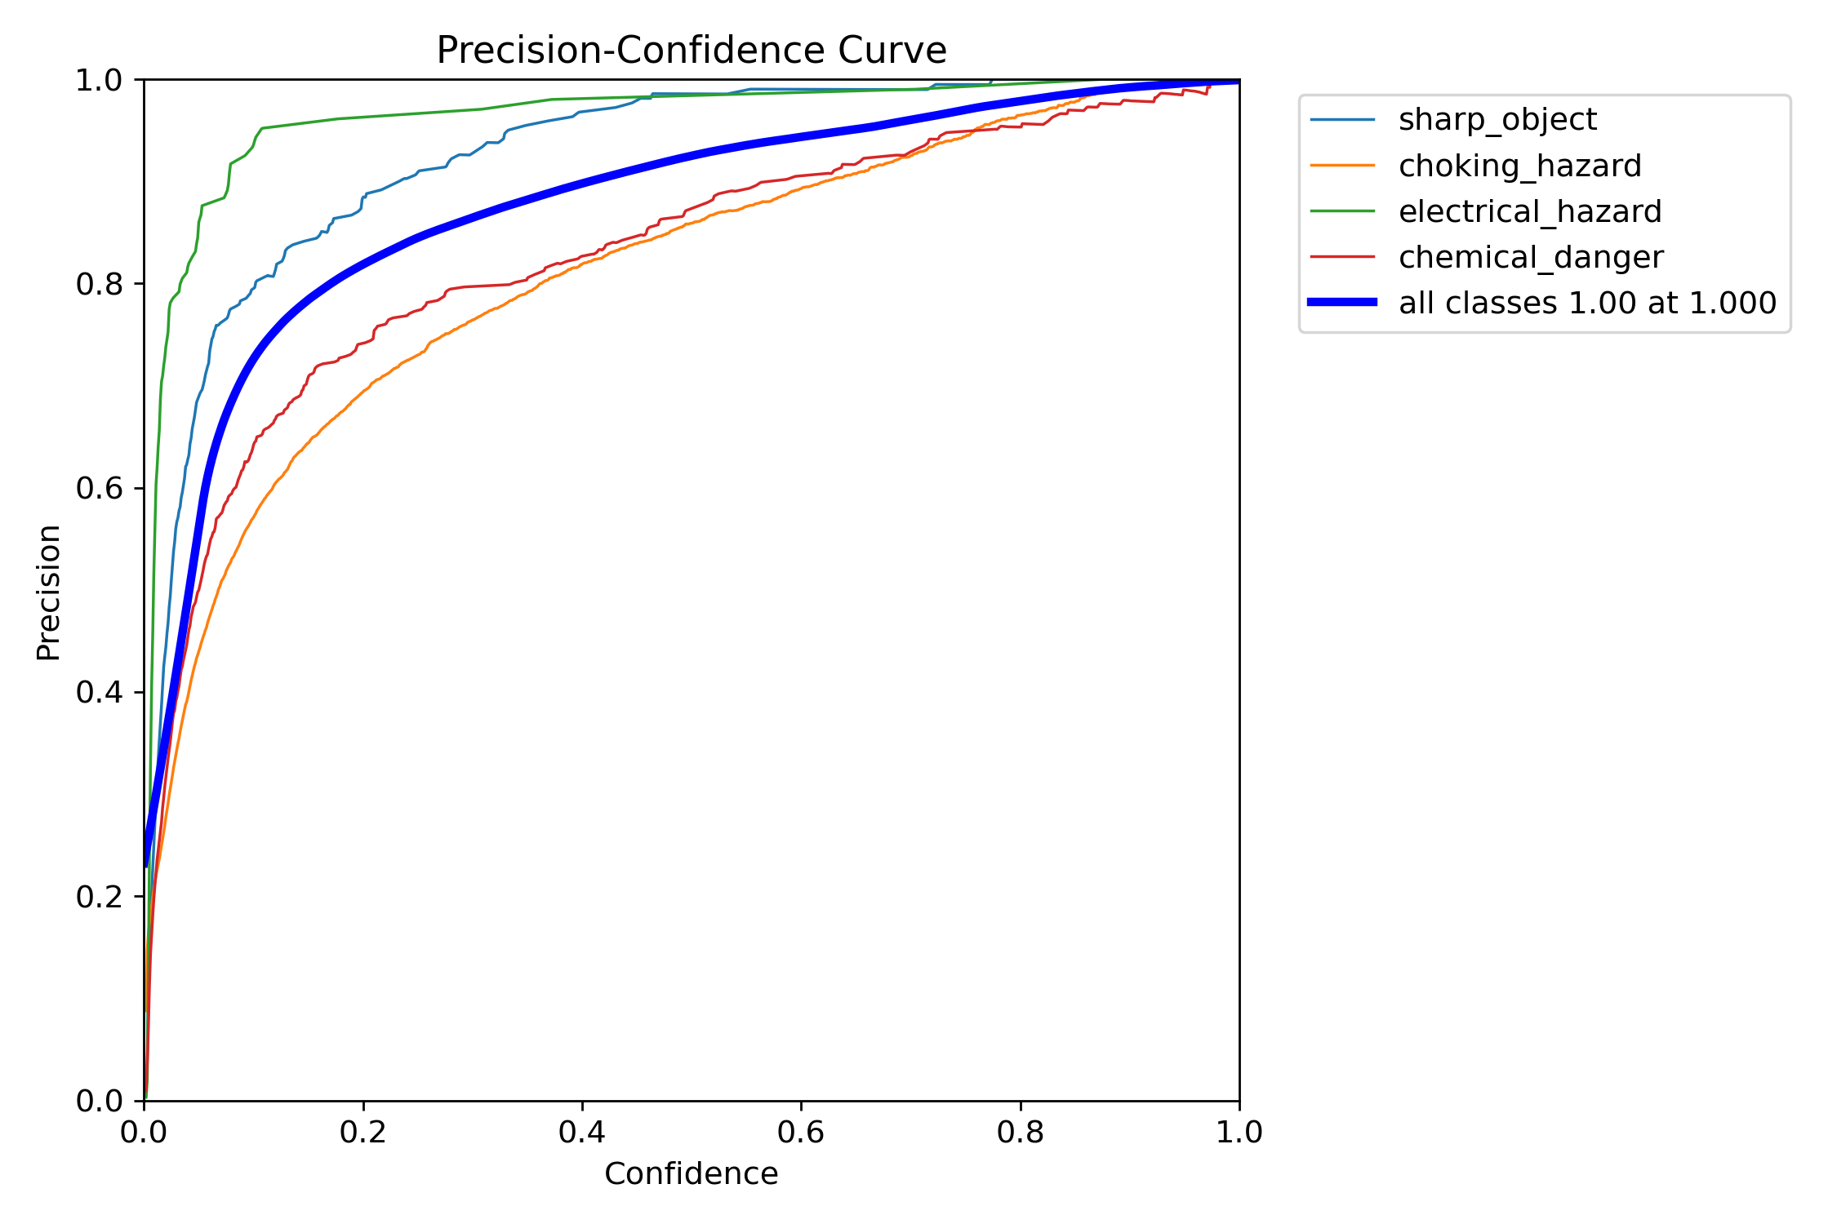
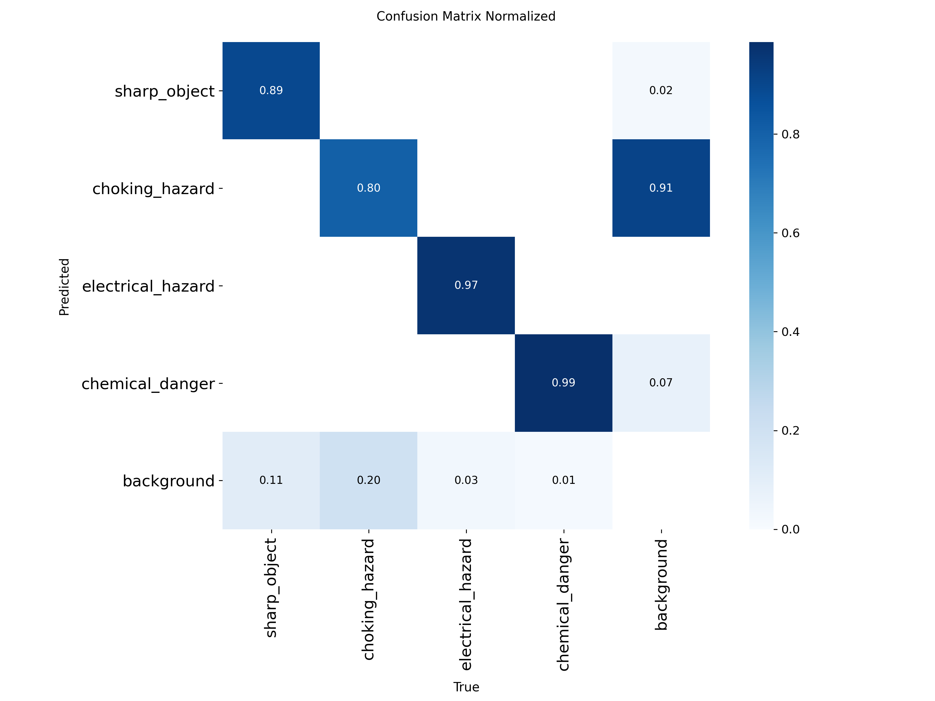
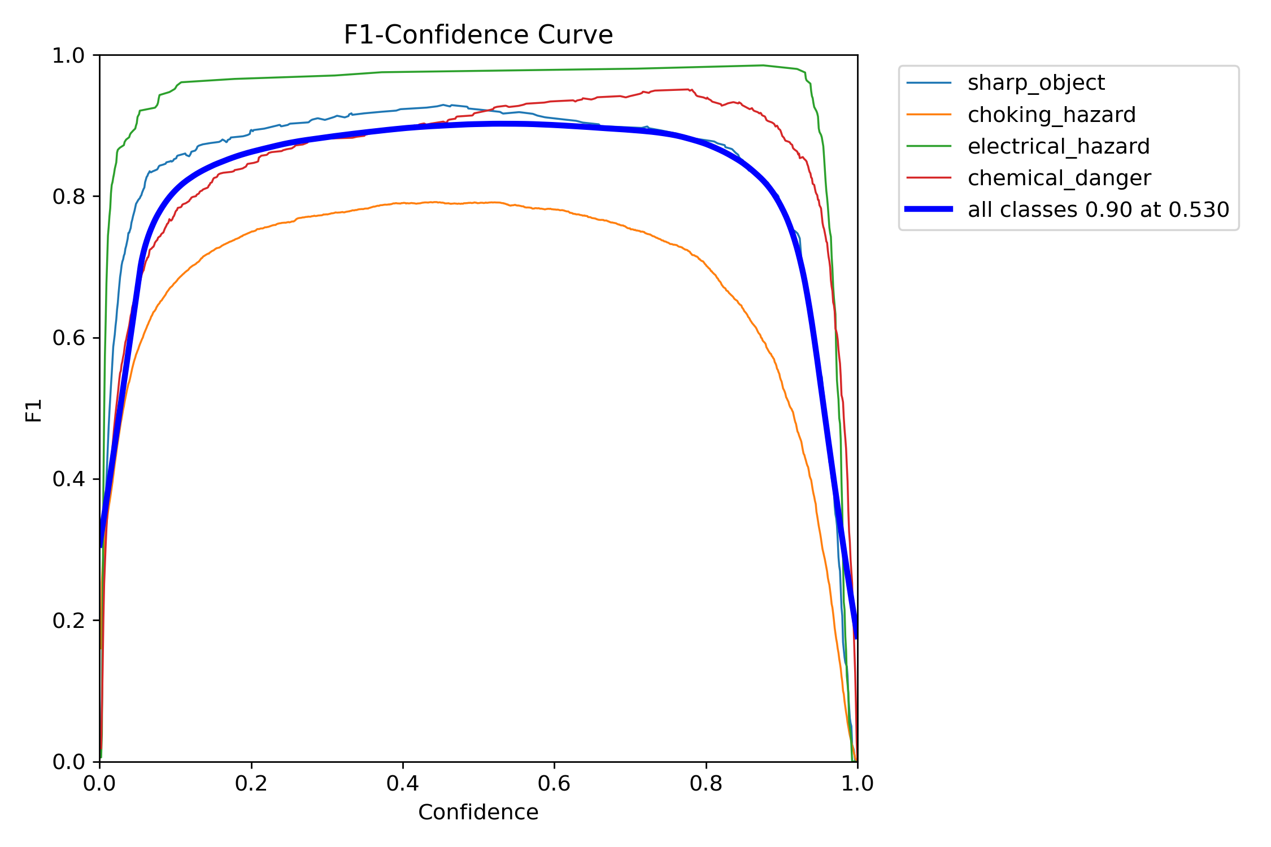
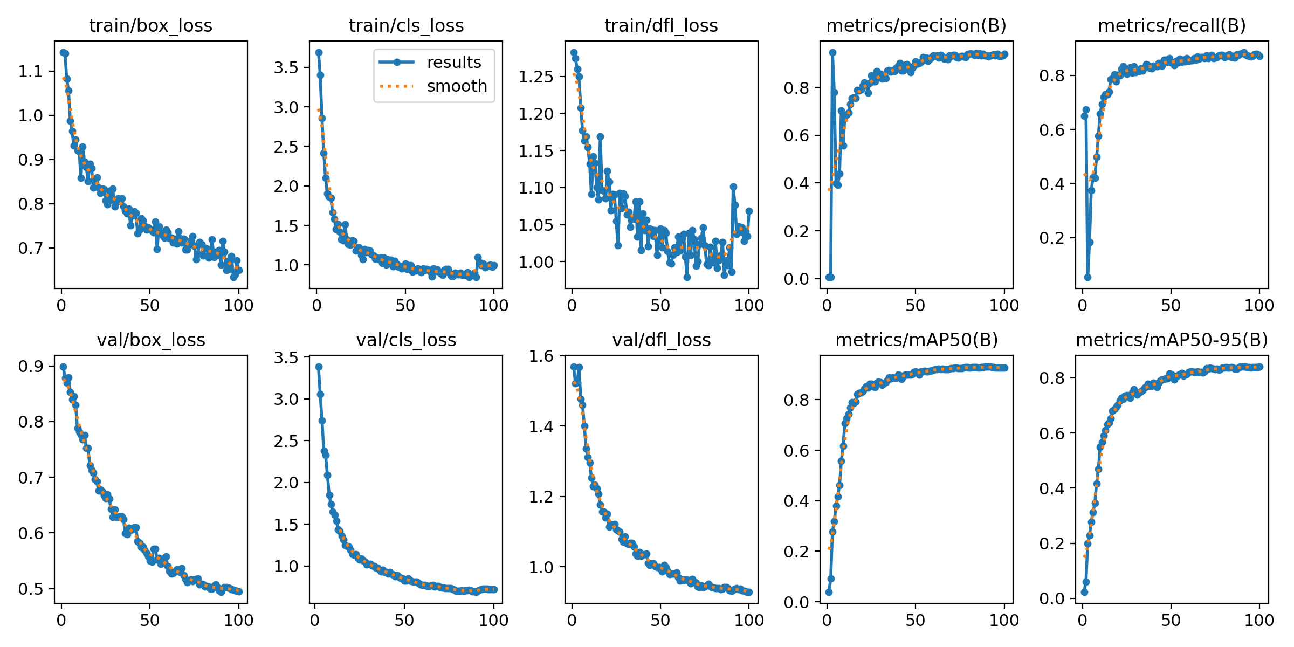
The results of a test models

Slide 20
Conclusions
• AI-based computer vision can effectively detect hazards in children’s rooms
• Synthetic data helps address privacy and ethical concerns, but works best when combined with real data
• Hybrid models significantly improve detection accuracy and reduce false positives
• Separating object detection from hazard classification creates a modular and explainable system
• The proposed solution has strong potential for real-world use in smart homes and child safety systems

